Slide 1
Parasite Eggs Identification
UniNa - Data Mining 20/21 - MiniContest n3

Slide 2
Introduction
Introducing the problem

Slide 3
Introduction
The contest aims at the detection of parasite eggs in microscopic images. It is a binary classification problem, since the model must predict one of the following classes:
  uovo (egg): meaning that the image contains a parasite egg;
  empty, meaning that the image does not contain any egg.
The prediction model must be able to correctly predict the presence of an egg for each image in the test set. The performance measure to maximize is the accuracy of the model.
A full explanation of the problem can be found here.

Slide 4
Exploratory Data Analysis
Data understanding

Slide 5
Exploratory Data Analysis (1/4)
Extract some useful information from the path of the images. Each training image is characterized by the following attributes:
  path: path where the image file is located.
  acquisition: acquisition in which the image was collected.
  name: name of the image.
  direction: orientation of the image. The same image may be present in the dataset with different orientation. This was made to balanced the class of the data, since the egg images were less in number. A better explanation about direction can be found here.
  label: label of the image.

Slide 6
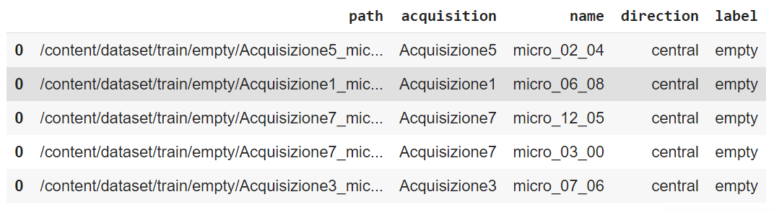
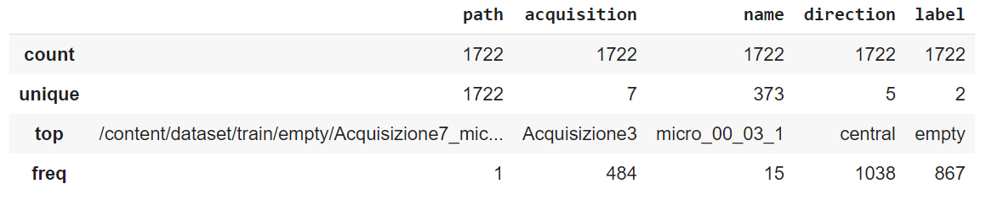
Exploratory Data Analysis (2/4)
To simplify the data analysis stage, build a dataframe containing the information extracted:
Compute some basic descriptive statistics about data:

Slide 7
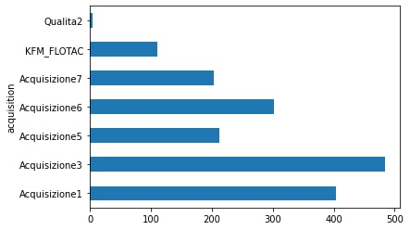
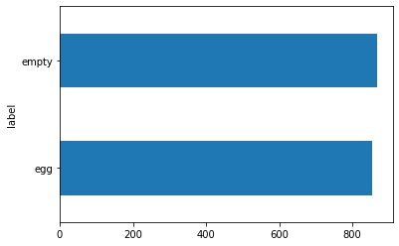
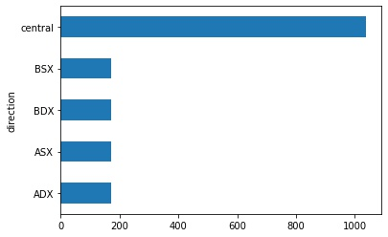
Exploratory Data Analysis (3/4)
Different acquisitions have a different number of images.
Thanks to multiple directions, training set is balanced in term of class.
For each egg image there are all the five directions

Slide 8
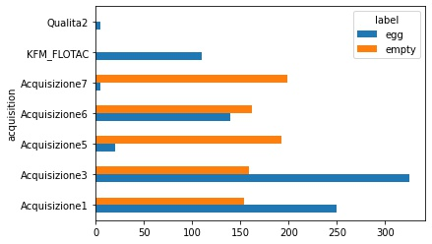
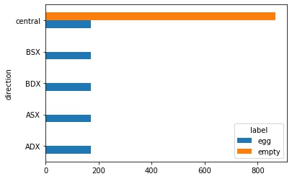
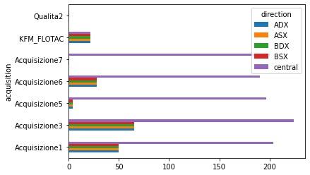
Exploratory Data Analysis (4/4)
Class distribution for different acquisition
Different directions are used only for egg images
Different directions of the same image refer to the same acquisition.

Slide 9
Data preparation
Preparing data for models

Slide 10
Data preparation (1/3)
Apply a stratification holdout technique, dividing the training set in 3 different dataset: training set (60%), validation set (20%), test set (20%).
  Stratification ensure that the class are balanced in all the subsets.
  Moreover, the tree subset should be made up of different acquisitions to be as independent as possible.
Validation set
Test set
Training set

Slide 11
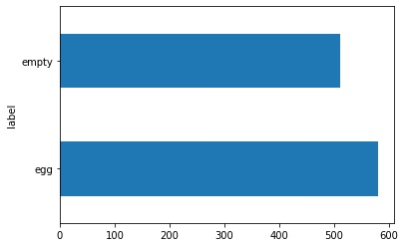
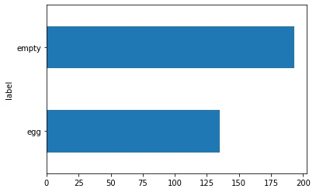
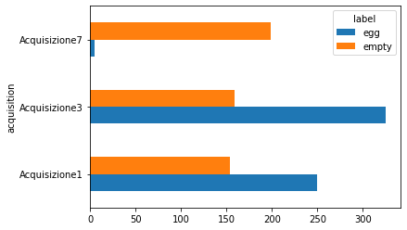
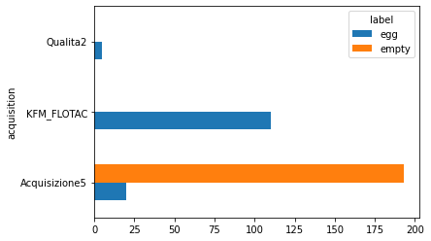
Data preparation (2/3)
Datasets used for hyperparameters tuning:
Training set (~63%)
Validation set (~19%)

Slide 12
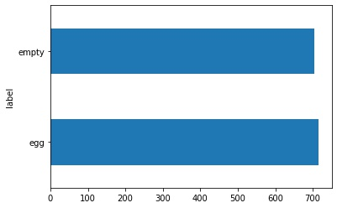
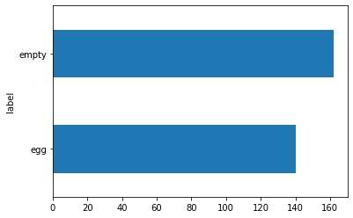
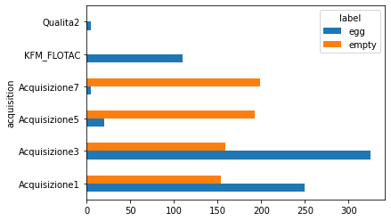
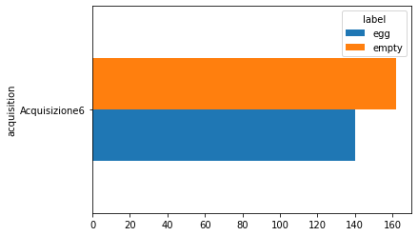
Data preparation (3/3)
Datasets used for performance evaluation and model selection:
Training and validation set (~82%)
Test set (~18%)

Slide 13
Modelling
Seeking the best model

Slide 14
Modelling
Deep learning approaches were used to face the problem.
The modelling stage consists in two main steps:
  Hyperparameters tuning: process of choosing a set of optimal hyperparameters of a model.
  Model selection: process of comparing different models’ performance on an independent test set.
Both steps was performed considering three different neural networks:
  AlexNet
  VGG11_bn
  GoogLeNet

Slide 15
Hyperparameters tuning (1/4)
Given a certain model, train it on training data and evaluate his performance on validation data.
  Repeat this procedure looking at model's performance and changing the hyperparameters accordingly.
  The whole process will be repeated for different models.
For each model, the following hyperparameters were considered:
Hyperparameter | Description
mode | feature extraction, fine tuning or mixed
batch_size | size of batch
num_epochs | number of epochs to perform
loss_function | function to minimize during the training
optimizer | optimization algorithm used to train the model
learning_rate | learning rate used by the optimization algorithm

Slide 16
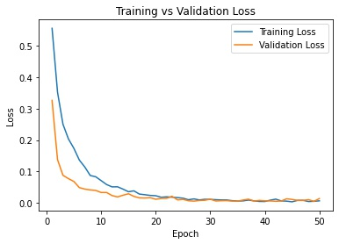
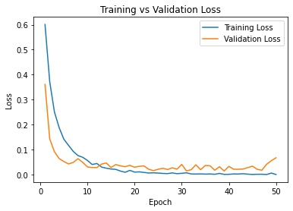
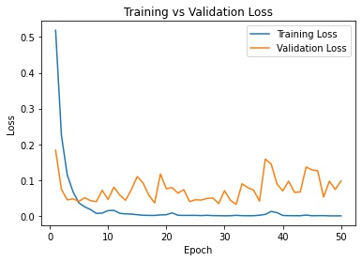
Hyperparameters tuning (2/4)
Hyperparameters can be tuned by means of learning curves, plots that show how learning performance (loss and accuracy) changes over epochs, on train and validation set.
  Es: tuning the learning mode (VGG11_bn)
Feature extraction
Mixed
Fine tuning

Slide 17
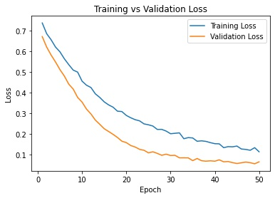
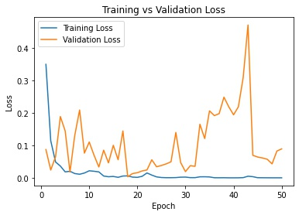
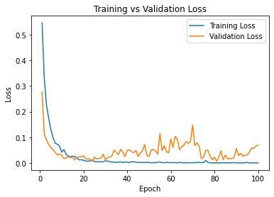
Hyperparameters tuning (2/4)
  Es: tuning the learning rate (VGG11_bn)
Low learning rate
Good learning rate
High learning rate
  Es: tuning the number of epoch (VGG11_bn)
num_epochs ~ 30

Slide 18
Hyperparameters tuning (1/4)
AlexNet
Hyperparameter | Value
mode | Feature extraction
batch_size | 32
num_epochs | 30
loss_function | cross entropy
optimizer | Adam
learning_rate | 0.00001
VGG11_bn
Hyperparameter | Value
mode | mixed
batch_size | 32
num_epochs | 30
loss_function | cross entropy
optimizer | Adam
learning_rate | 0.00001
GoogLeNet
Hyperparameter | Value
mode | fine tuning
batch_size | 32
num_epochs | 30
loss_function | cross entropy
optimizer | Adam
learning_rate | 0.00001

Slide 19
Model selection
Train each model on the union of training and validation data, with the hyperparameters found in the previous stage.
Evaluate models’ performance on an independent test set.
  The model that gains the best performance on the test set is chosen for the submission.
Model | Accuracy on test set | Accuracy on public leaderboard | Accuracy on public leaderboard
AlexNet | 0.79139 | - | -
VGG11_bn | 0.95364 | 0.98058 | 0.95748
GoogLeNet | 0.97019 | 0.98058 | 0.98897
Select GoogLeNet as final model

Slide 20
Submission
Submitting the solution found

Slide 21
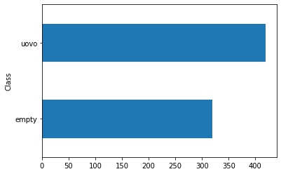
Submission
Train the final model using the whole training set.
Predict the class label for the instances of the (original) test set.
  Plot the class distribution of the test images:
Create the submission file.

Slide 22

Questions ?

